Slide 1

LOAN DEFAULT PREDICTION USING MACHINE LERANING
Model Development, Insights, and Limitations
Presentation by Andy Joseph

Slide 2
OBJECTIVE
Analyze historical loan data and build a model that predicts whether a borrower will default on their loan

Slide 3
TOOLS USED
APPROACH
Data Collection
Data Preprocessing
EDA
Feature Engineering
Data Balancing & Scaling
Model Selection
Hyperparameter Tuning
Deployment with Streamlit
Python
Numpy
Pandas
Scikit-learn
Streamlit
>>>>>>>>>
>>>>>>>>>

Slide 4
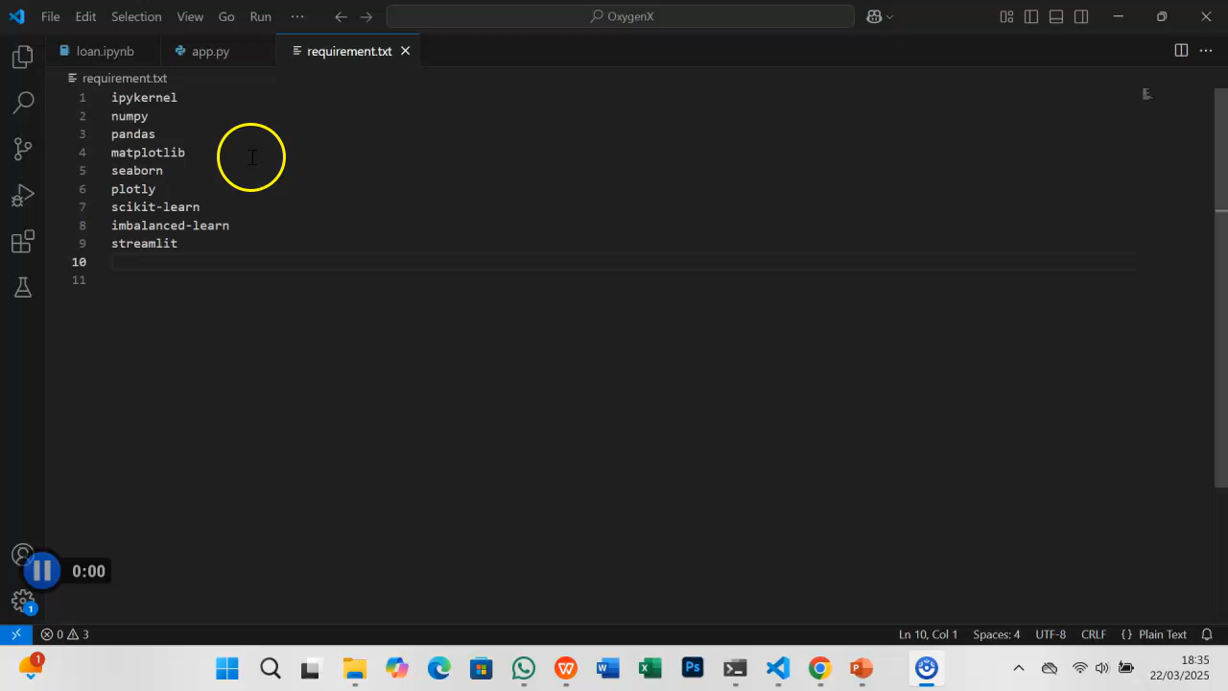
Loan Default Prediction: Model Demonstration
This presentation showcases the loan default prediction model, highlighting key data insights, model performance, and practical applications. Through a brief video demonstration, we explore how the Streamlit app predicts loan defaults, helping lenders make informed decisions and minimize risk.

Slide 5
KEY INSIGHTS
01
High-risk borrower (low credit scores, multiple loans) may need closer evaluation.
02
Income-based lending policies can help tailor loan offers to financial capacity.
03
Missed payments suggest financial stress
04
Shorter tenures (12-24 months) dominate, indicating borrower preference for manageable repayments.

Slide 6

LIMITATIONS
Limited features and data diversity
Imbalanced dataset
Non-defaulters make up over 80% of the data, leading to bias in model predictions
Even after introducing new features, the model performance remained unchanged, indicating the need for more diverse data.
01
02
Employment status and default relationship
Imbalanced dataset
03
04
The confusion matrix shows that some models (e.g Logistic regression, Support vector machine) failed to predict any defaulters.
While full-time employees had the highest default rate, the dataset does not capture income stability or other risk factors that could explain this trend.
05
06
07
Need for Alternative Risk Assessment Approaches
BEHAVIOURAL INSIGHT
The dataset lacks behavioural insights like spending patterns that could improve prediction accuracy.
Traditional credit scoring methods may not be enough – machine learning models integrating transaction history and financial habits could improve risk evaluation.
Low recall and predictive power
Many models struggle to identify defaulters, especially those with low recall and AUC scores.

Slide 7
RECOMMENDATIONS
Enhance Risk Assessment & Data Collection
Use alternative credit scoring models for better borrower evaluation
Flexible Loan Repayment Plans
Adjust repayment schedules based on income stability and employment type
Flexible Loan Repayment Plans
Offer income-based repayment options for self-employed and part-time borrowers
Financial Literacy & Advisory Support
Provide personalized repayment guidance for high-risk borrowers
Incentives & Early Repayment Benefits
Offer graduated interest plans to encourage consistent payments.
Advanced Monitoring & Intervention
Use early warning systems to detect high-risk borrowers.
Advanced Monitoring & Intervention
Implement AI-driven alerts for upcoming payments and financial risks.

Slide 8
FUTURE WORK
Improve Data Balance
Expand Dataset
Continuous Model Improvement
Collect a more balanced dataset to enhance model generalization
Incorporate additional features, such as behavioral insights, to improve predictions.
Regularly retrain the model with new data to maintain accuracy and adapt to changing trends.

